Slide 1
New York City Airbnb
Rental Market Analysis
By: Akshita Pathania

Slide 2
Problem Statement
Objective
Analyze the New York City Airbnb rental market to identify factors that influence rental prices and occupancy rates, and provide insights on market trends and patterns.
To conduct a comprehensive analysis of the New York City Airbnb rental market to identify the key factors that influence rental prices and occupancy rates. By leveraging data-driven insights, the study aims to provide actionable recommendations for hosts to optimize their listings, improve booking rates, and enhance overall market performance.

Slide 3
Tools Used
Google Colab: This platform is utilized for cleaning and preprocessing the data before analysis using Python.
Tableau: For creating interactive dashboards and visualizations to better understand and convey the insights derived from the data.
Google Slides: After analyzing the data, the findings are presented using Google Slides for clear and effective communication.

Slide 4
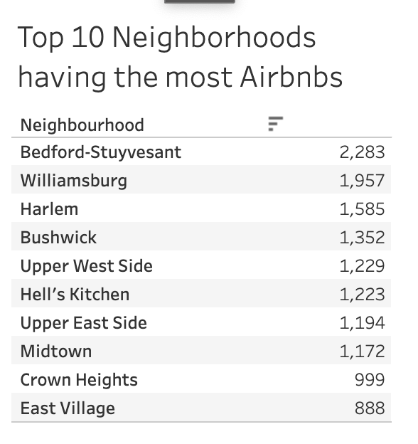
This table lists the top 10 hosts with the most Airbnb listings in New York City.
Insights on average prices by neighborhood and room type can guide hosts in setting competitive prices.
Segmenting neighborhoods into premium, mid-range, and budget categories helps in targeted marketing and investment.
Understanding the concentration of listings among top hosts provides insights into market control and competition, aiding in strategy formulation and policy making.

Slide 5
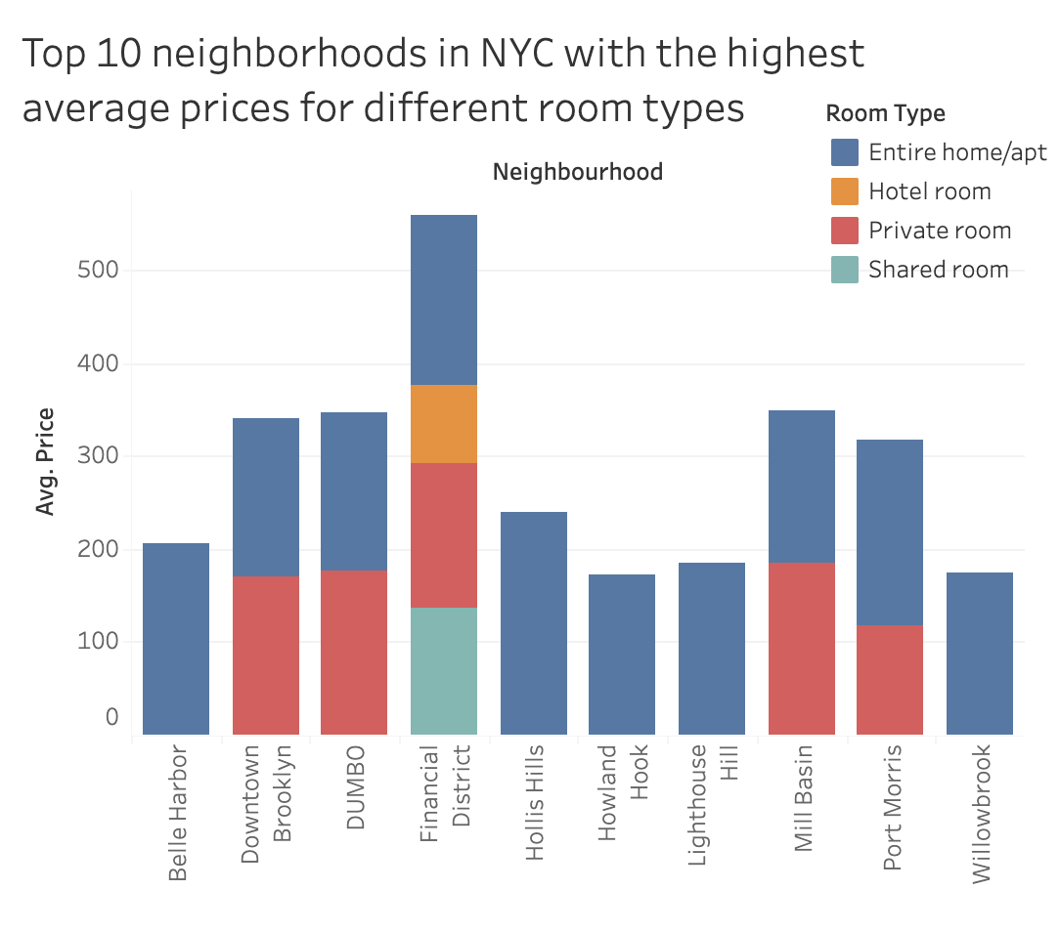
This bar chart shows the average prices for different room types across the top 10 neighborhoods in NYC with the highest average prices.
This visualization identifies neighborhoods with higher prices and different room pricing.
It guides hosts on optimal pricing based on neighborhood and accommodation type.
It also helps segment the market for targeted marketing and investment strategies.

Slide 6
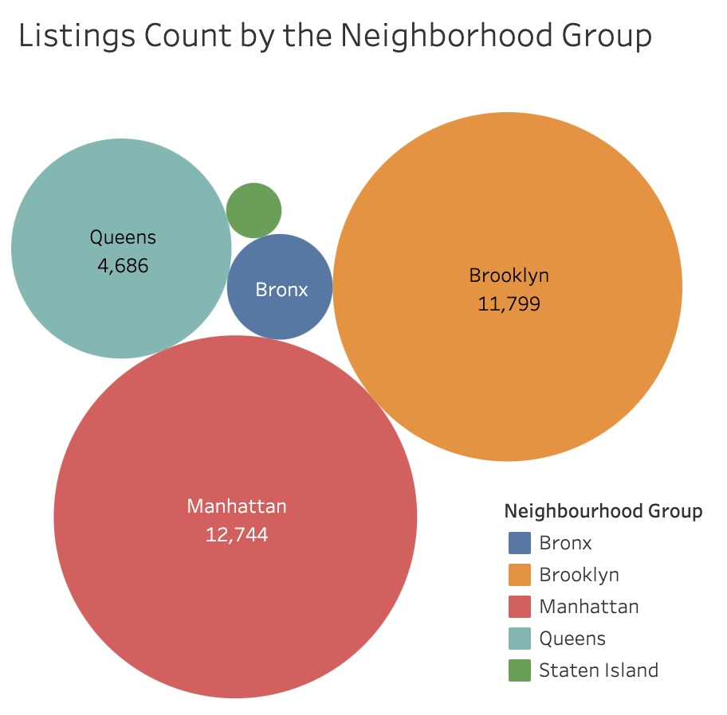
This packed bubble plot illustrates the distribution of Airbnb listings across various neighborhood groups.
It helps identify the neighborhood groups with the highest number of listings, highlighting areas of high competition and potential market saturation.
It can also help identify the underrepresented neighborhood groups where there may be opportunities for new listings.

Slide 7
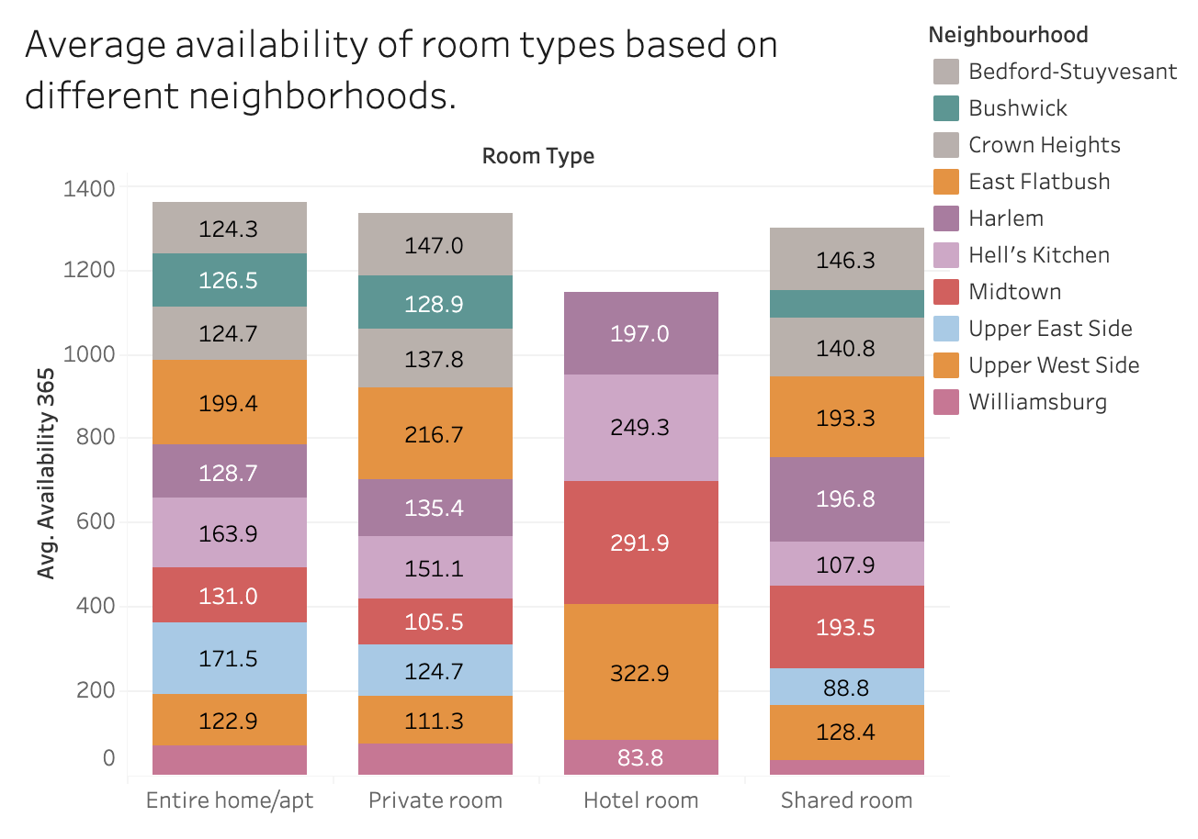
This stacked bar plot illustrates the average availability of different room types in various neighborhoods.
It helps to comprehend which room types are more frequently available in specific neighborhoods, indicating possible issues with occupancy rates.
Hosts can utilize this information to adapt their listing types according to neighborhood trends and enhance occupancy rates.

Slide 8
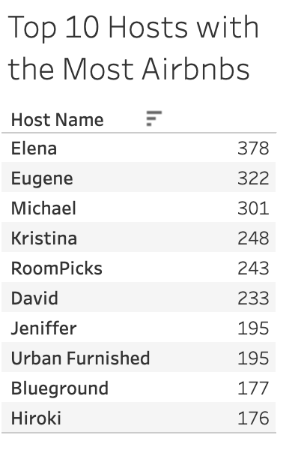
The following table shows the top 10 hosts with the highest number of Airbnb properties in New York City.
It offers insights into the distribution of listings among top hosts, indicating market control and competition dynamics.
New hosts can use this information to learn from the successful listing practices of these top hosts.

Slide 9
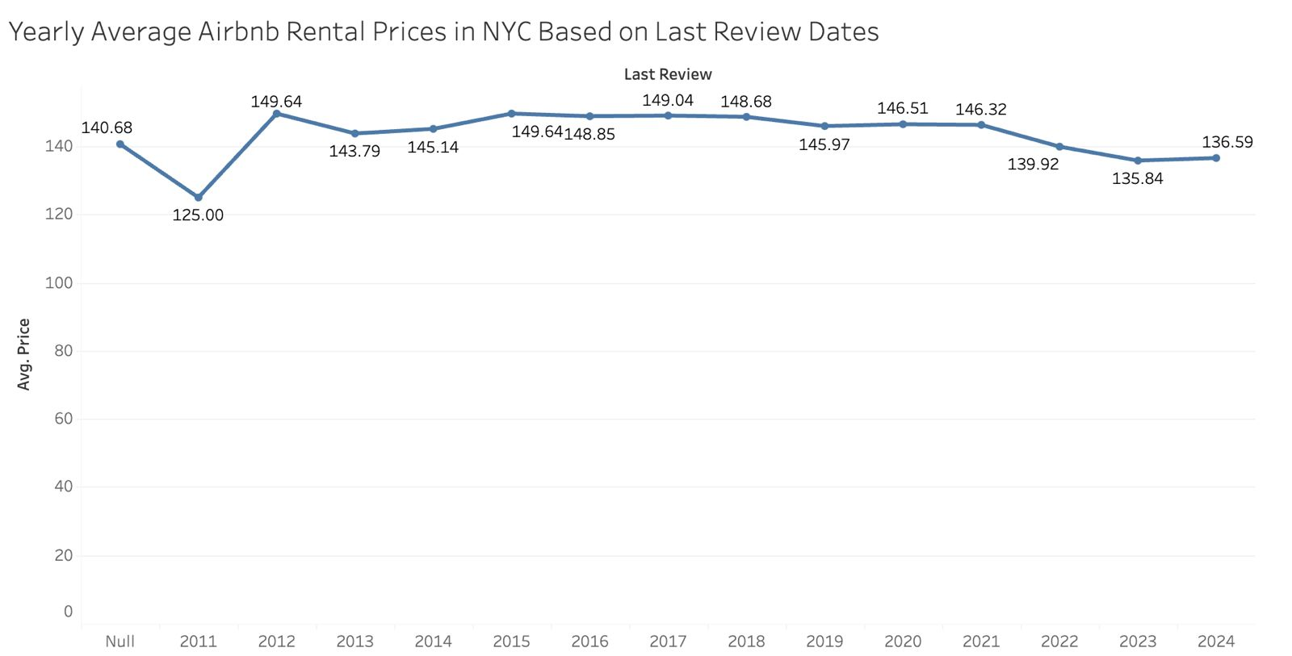
This line chart shows how average rental prices have changed over time. Hosts can use this information to set competitive prices and adjust their pricing strategies based on expected seasonal demand.
It offers a big-picture view of market trends, which can help with forecasting future price movements.

Slide 10
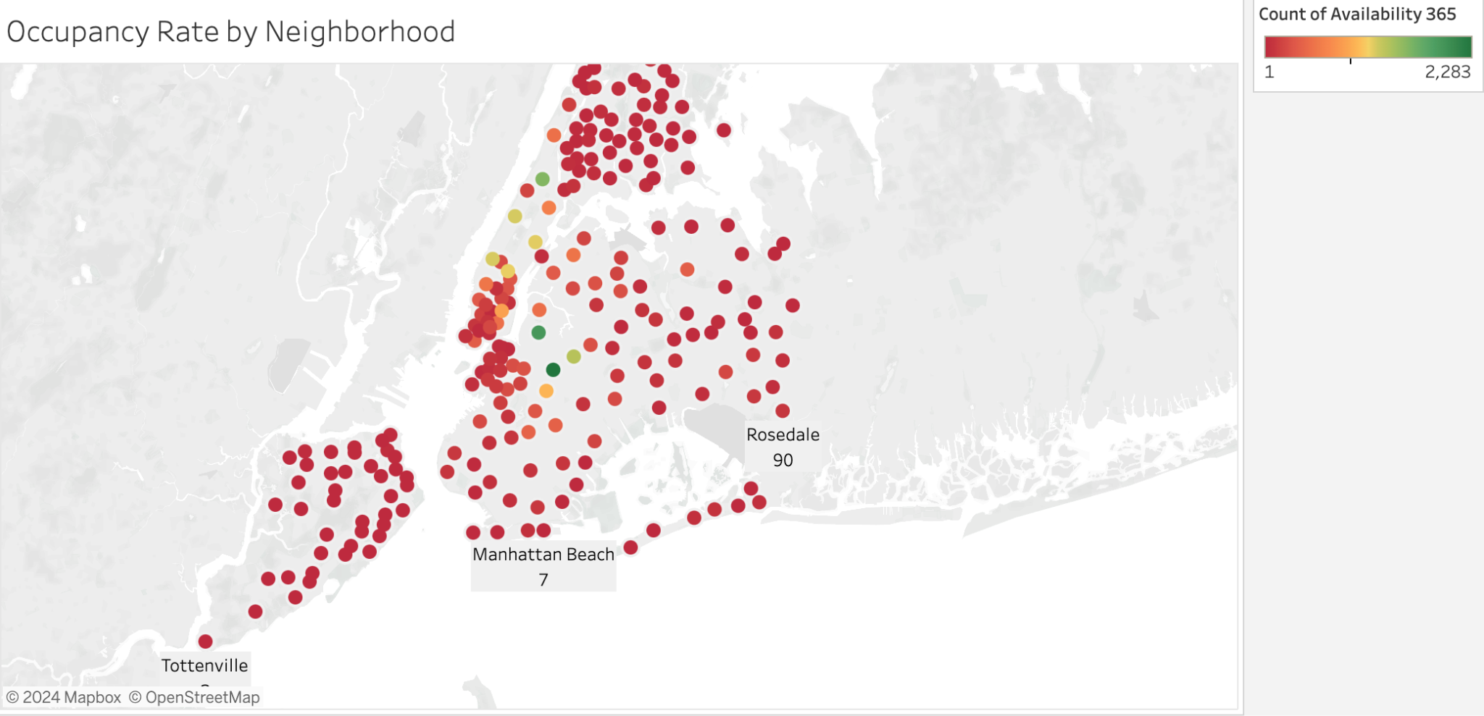
This map illustrates the occupancy rates in various neighborhoods across New York City. It assists hosts in understanding the neighborhoods with higher demand, enabling them to optimize their listings and improve booking rates.
Additionally, it offers a spatial analysis of occupancy trends, aiding in the identification of popular areas as well as those that are underperforming.

Slide 11
These visualizations offer a comprehensive analysis of the New York City Airbnb rental market, helping to identify key factors that influence rental prices and occupancy rates, and providing actionable insights on market trends and patterns.
THANK YOU!

